Slide 1
Description of lane properties
Wushuang Bai
2023 08 29

Slide 2
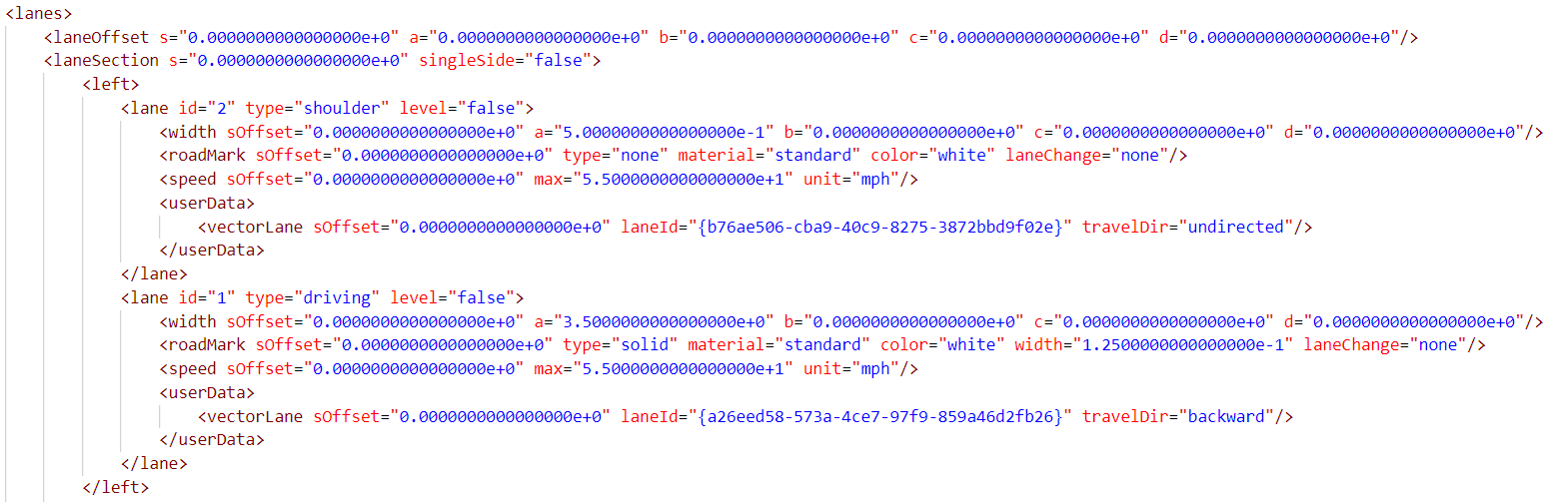
This document explains the properties to describe a lane based on ASAM OpenDrive 1.6. A driving lane is used as an example shown below.

Slide 3
Step 1. Lane offset is described.

Slide 4
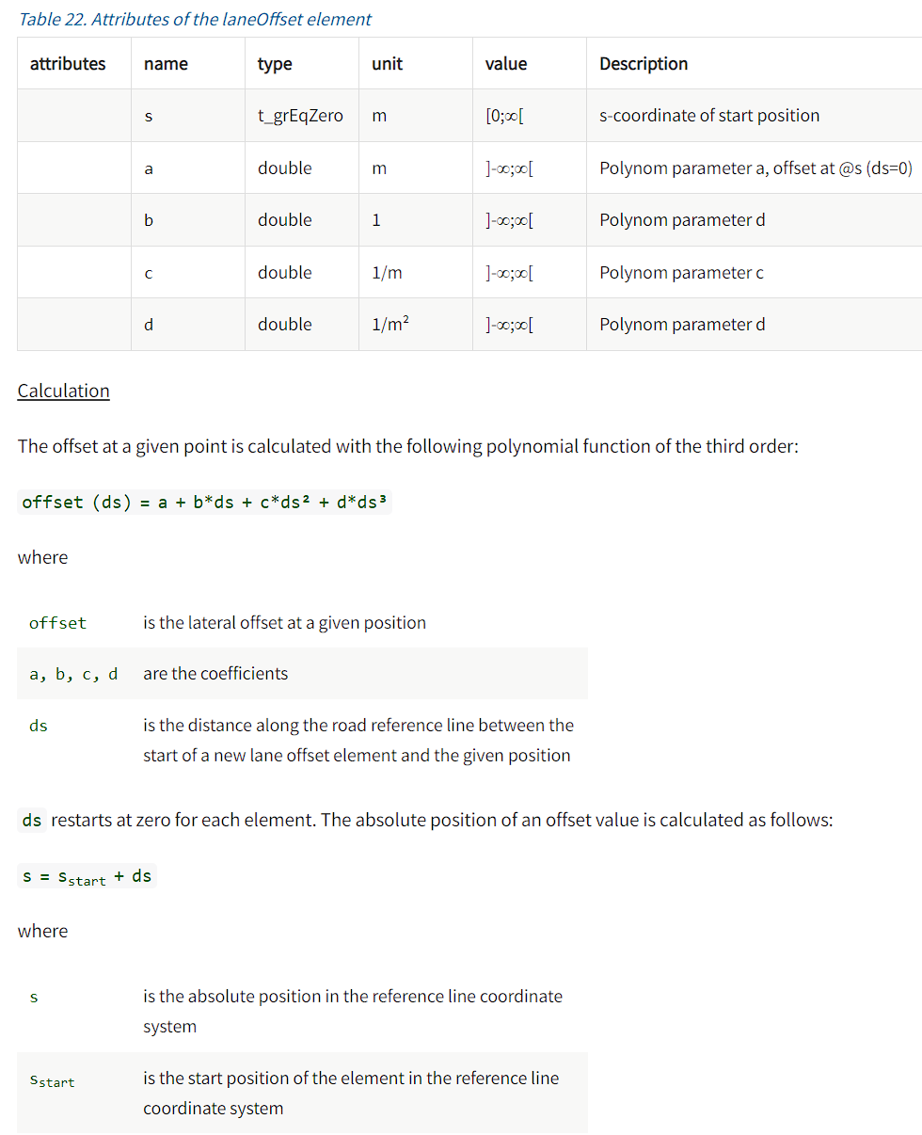
The attributes of lane offset are described below.

Slide 5
Step 2. Lane section is described.

Slide 6
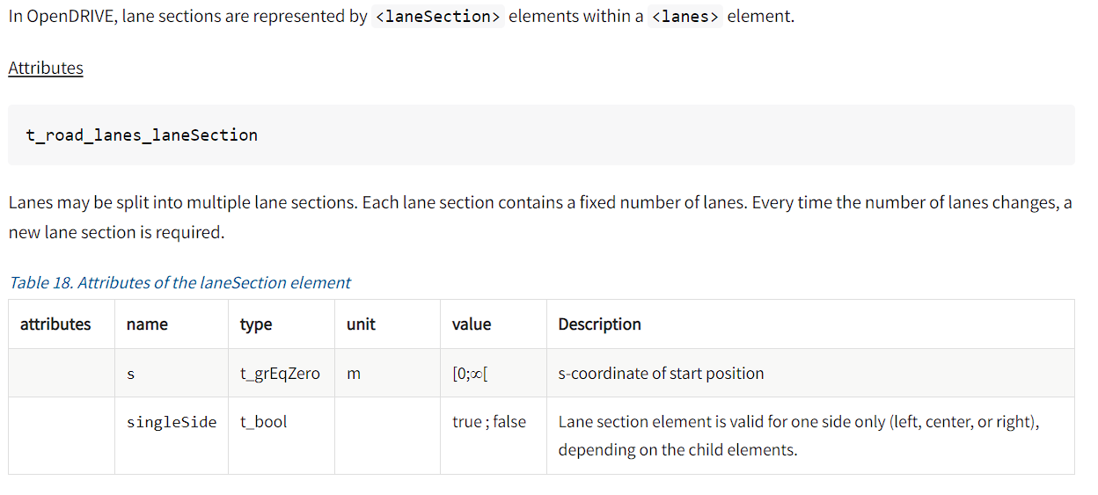
The attributes of lane section are below.

Slide 7
Step 3. Whether this lane is left, center, or right is described.

Slide 8
Step 4. Lane ID, type and level are described. Here we use the “driving” lane as example since this is the primary lane type we use.

Slide 9
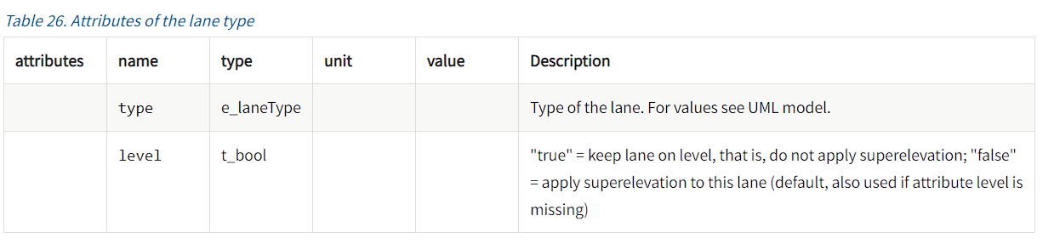
Step 4. Attributes of a lane type are below.

Slide 10
Step 5. Lane width is described.

Slide 11
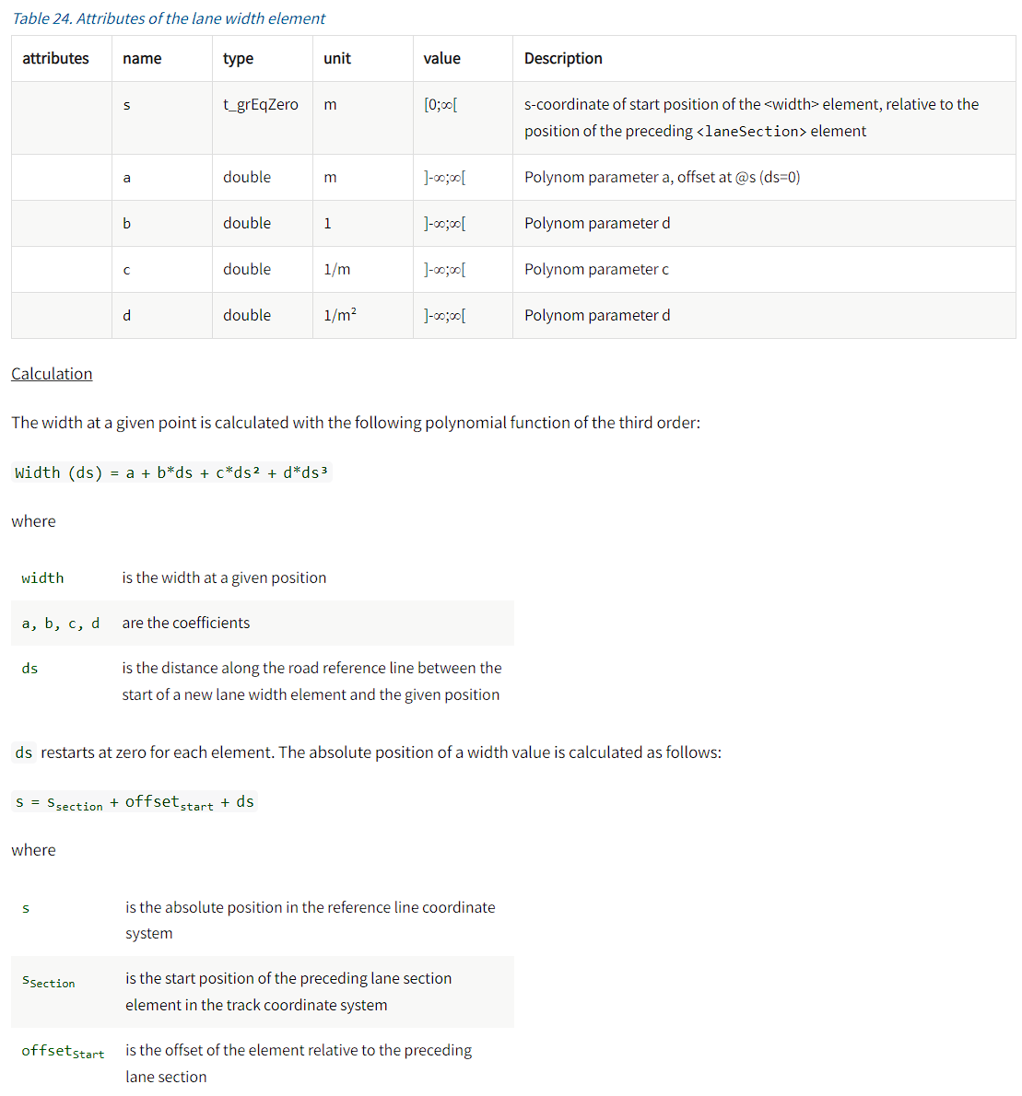
Step 5. Attributes of lane width are below.

Slide 12
Step 6. Road mark is described.

Slide 13
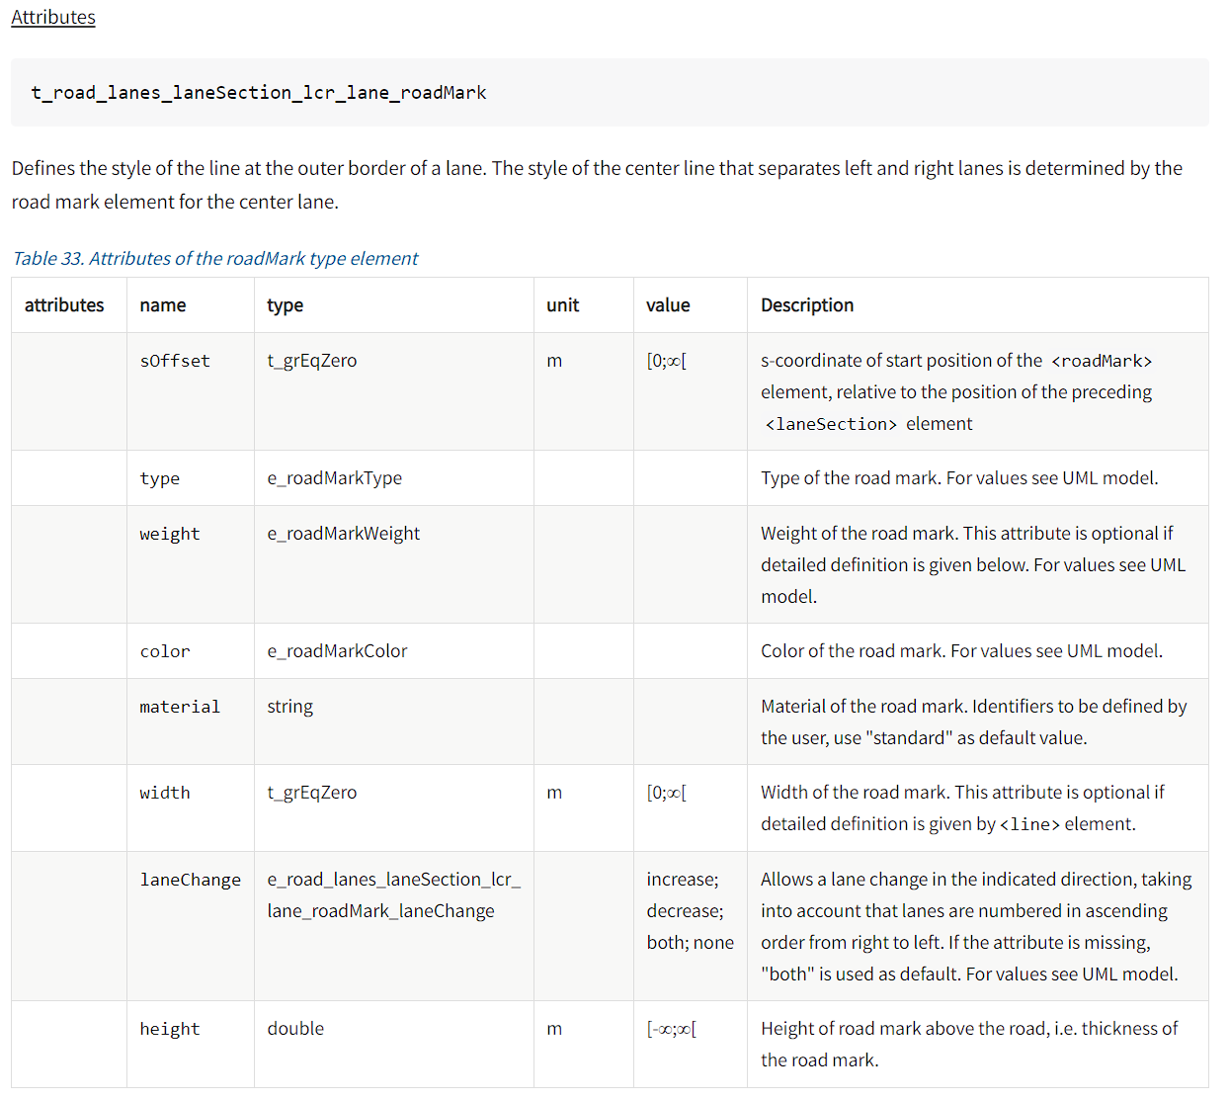
Step 6. Attributes of road mark are below.

Slide 14
Step 7. Lane speed is described.

Slide 15
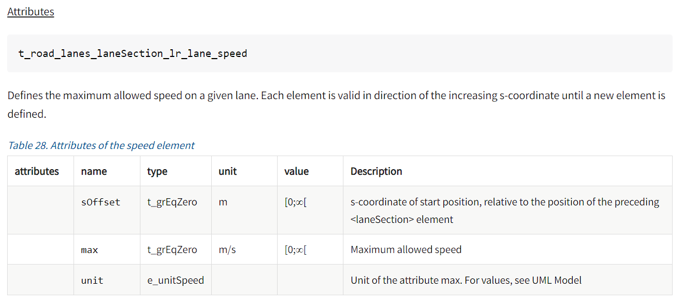
Step 7. Attributes of speed are below.

Slide 16
Step 8. UserData is described as “external” data. The attributes are not clearly defined in ASAM OpenDrive. However, this can usually be generated automatically by RoadRunner so it is not mandatory.

Slide 17
The example files used in this document can be found at https://github.com/ivsg-psu/PathPlanning_MapTools_ParseXODR/blob/main/Data/XODRExport/XODRExport/RR/02ExportedFromScene/RR_Junction_highwayPassing.xodr
For a complete explanation of lane properties, please see https://www.asam.net/index.php?eID=dumpFile&t=f&f=3495&token=56b15ffd9dfe23ad8f759523c806fc1f1a90a0e8#_lane_properties

